Slide 1

EduVision_DV
HIGHER EDUCATION INTELLIGENCE SYSTEM
FOR INSTITUTIONAL PERFORMANCE & ACADEMIC EXCELLENCE
Domain: Data Visualization & Higher Education Analytics
Internship Track: Infosys Springboard Internship 7.0
Author: Sujay S | September 2026

Slide 2
Technology Stack: The Analytics & BI Framework Explained
Python 3.11 ETL
Data Ingestion & Normalization
Star Schema
Dimensional Data Modeling
Tableau 2026
Interactive BI Dashboard Suite
Automated QA
Data Integrity Verification
Python / Pandas: Data Cleaning
Pandas & NumPy data pipeline, regex entity normalization, deterministic acronym stripping, and data imputation.
Star Schema: Relational Model
Centralized conformed dimension spine (dim_university, dim_country) linked to 4 analytical fact tables with 0 orphan records.
Tableau 2026: Interactive BI
4 interconnected dashboards, bidirectional action filters, dynamic parameter controls, and custom dark UI containers.
QA Engine: 12/12 Verified
12 automated integrity assertions (validate_and_test.py), 100% pass score, and multi-sheet audit Excel models.

Slide 3
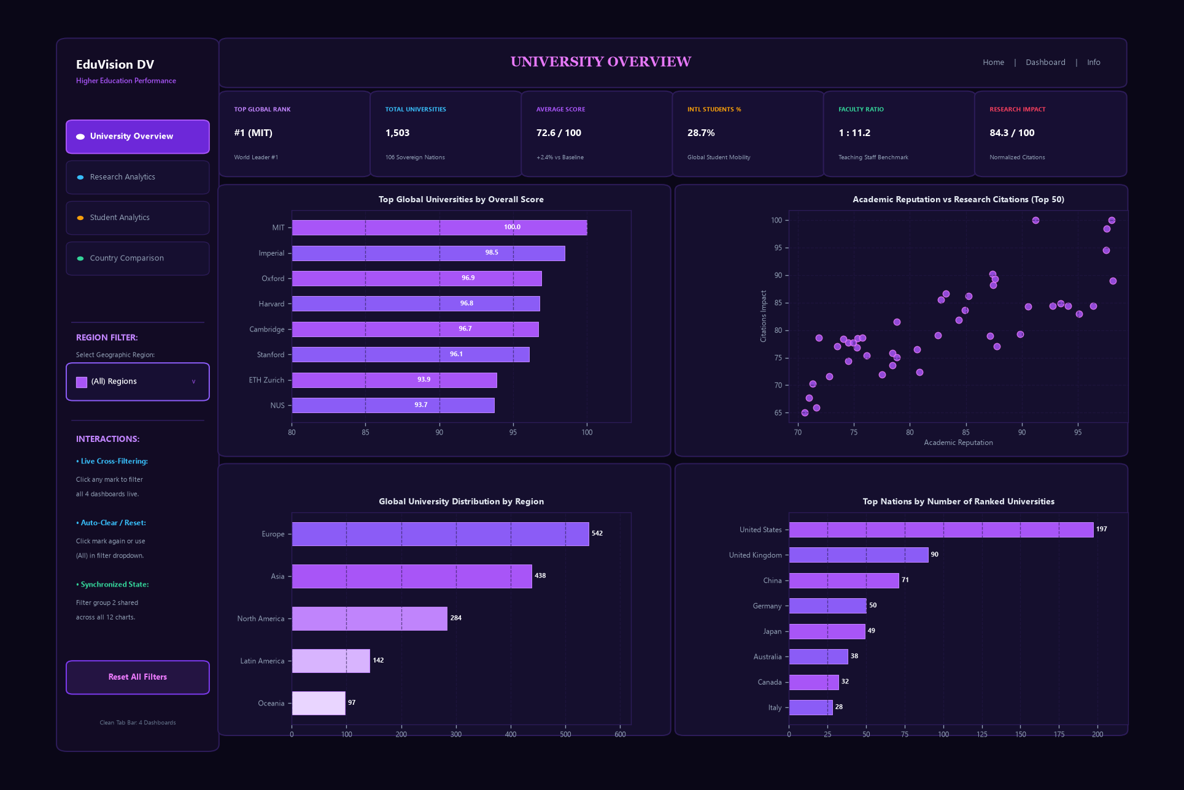
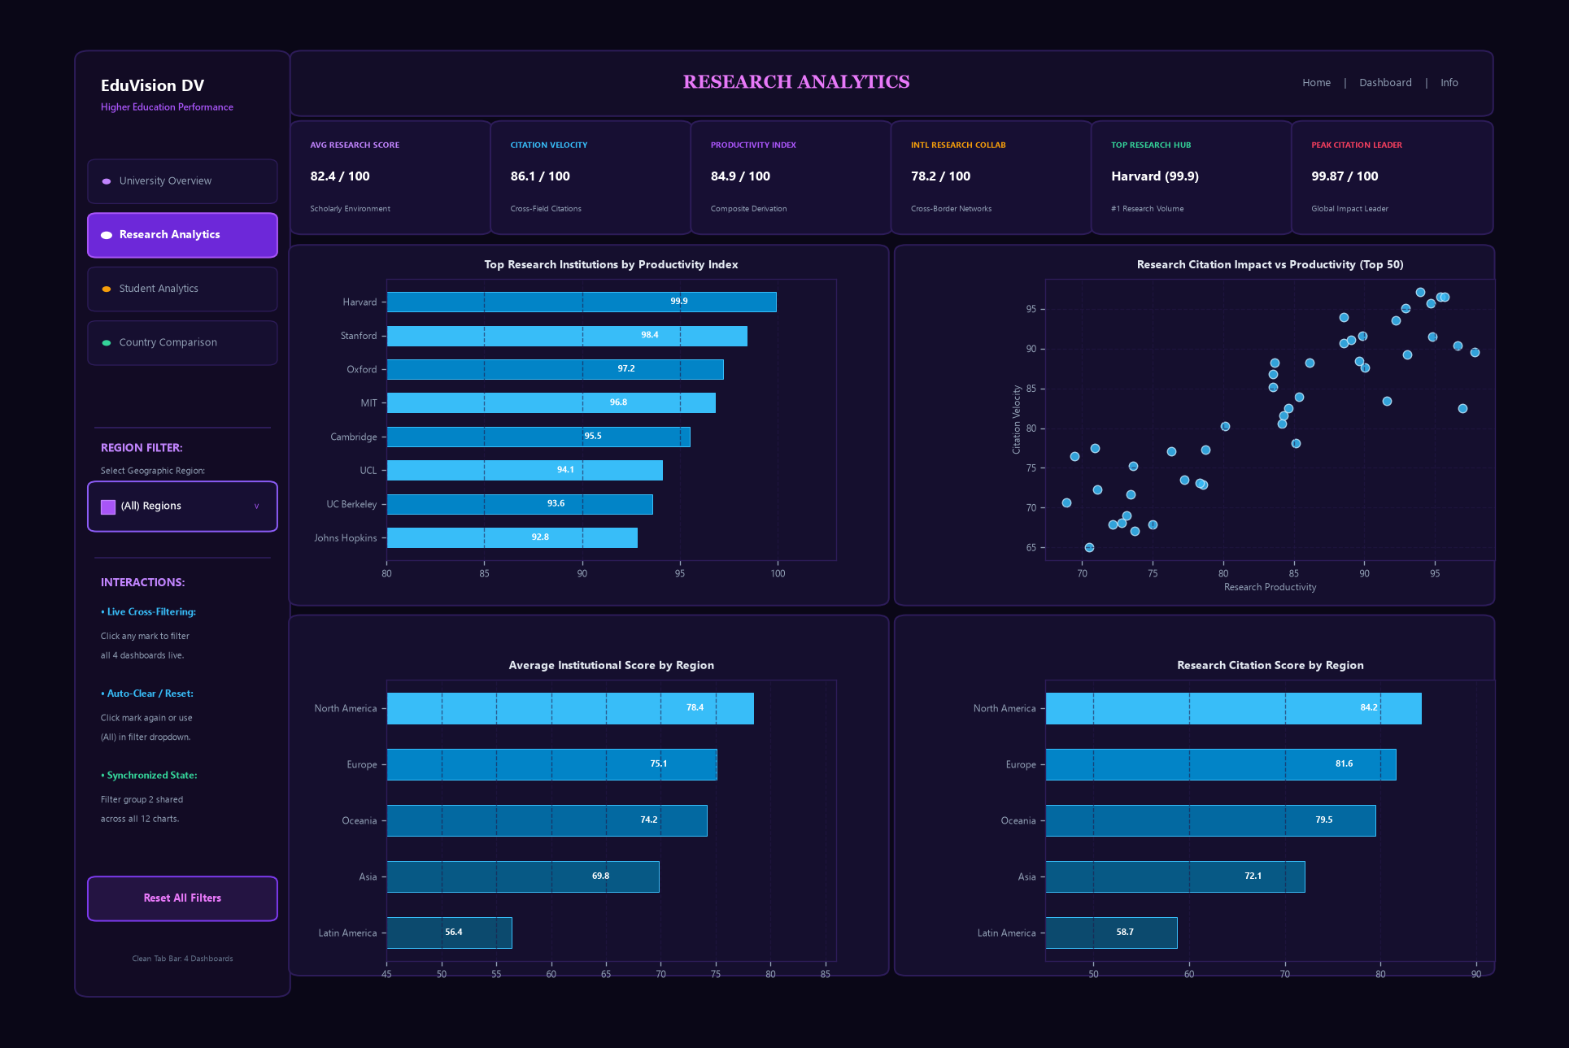
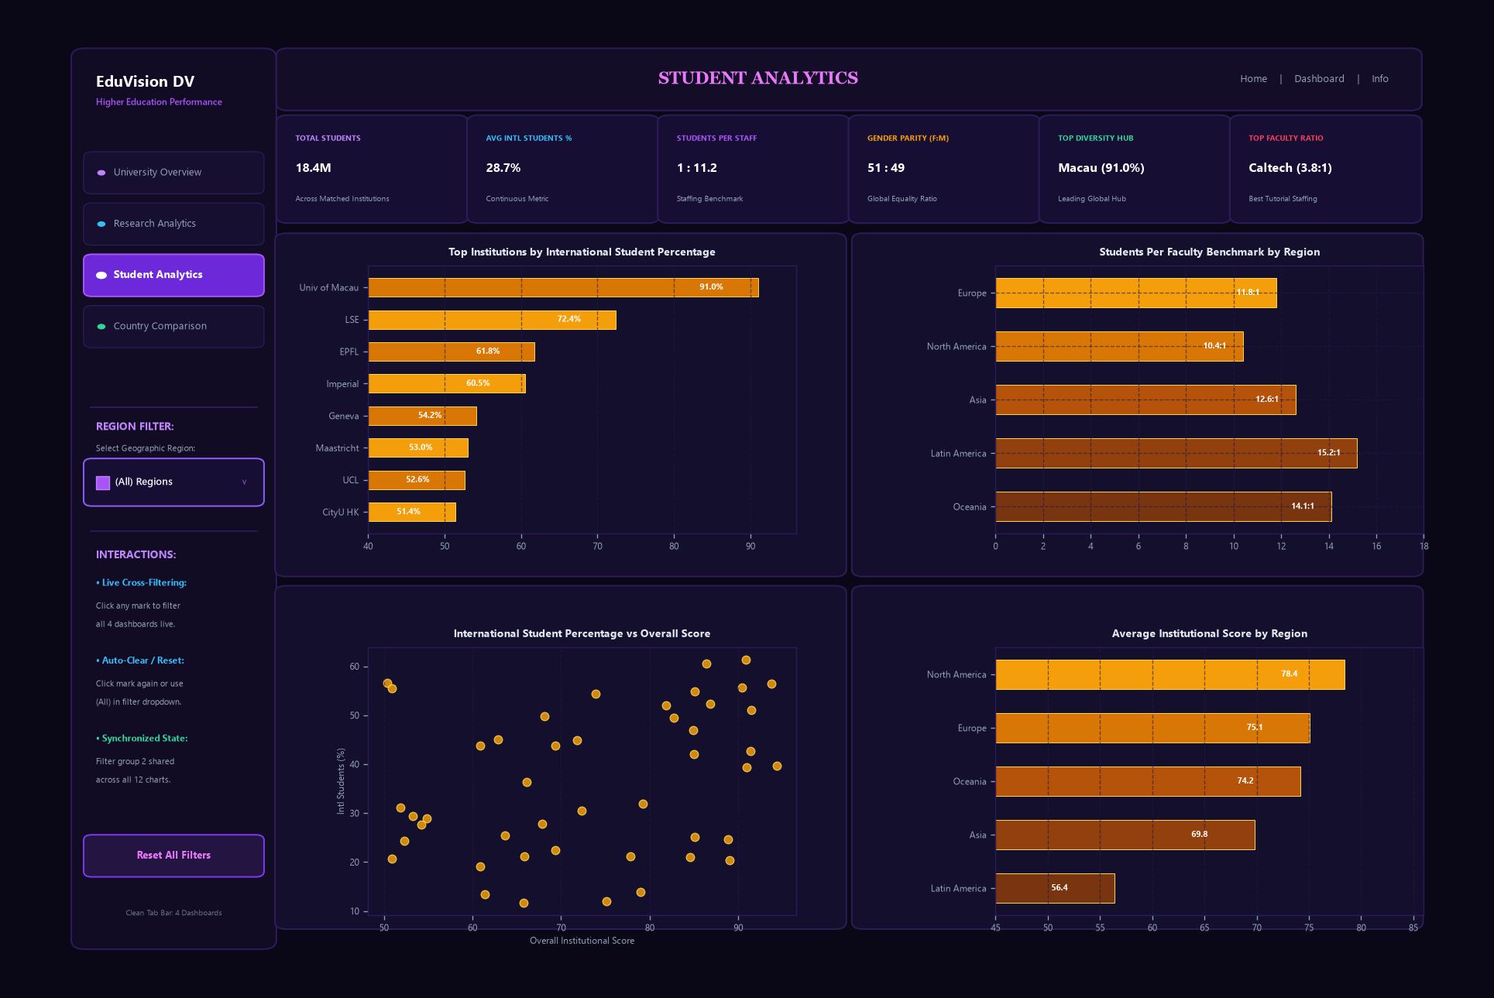
Core Features of EduVision_DV Platform
Institutional Benchmarking
Interactive landing scorecard providing global ranking matrices, academic reputation vs. score scatter, and choropleth geographic distribution.
Research Productivity & Citations
Deep-dive evaluation of citation impact per faculty member, international research network collaboration, and quadrant performance grids.
Campus Diversity & Policy Insights
Empirical faculty-to-student ratios, international student percentages, and World Bank public tertiary education expenditure benchmarks.

Slide 4

1
2
Challenges
Facing Higher
Education
Analytics
Critical structural and methodological barriers in multi-source institutional intelligence
Fragmented Data Sources
Rankings (QS, THE, WUR) and World Bank economic data reside in isolated silos with incompatible metrics, varying temporal windows, and divergent formats.
Acronym & Name Inconsistencies
Institutional names frequently include parenthetical acronyms (e.g., '(MIT)') or localized spellings, causing key mismatches and false merges in standard joins.
3
4
Metric Misrepresentation
Survey-based ranking scores (0–100 indices) are routinely conflated with actual empirical metrics, such as real student-to-staff ratios and headcounts.
Disconnected Policy Context
Institutional rankings operate in isolation from macro education economics, obscuring how national government expenditure (% GDP) drives academic excellence.

Slide 5

System Architecture Overview
The system architecture of EduVision_DV is designed to ensure audit-compliant data lineage, robust performance, and seamless cross-dashboard interactivity. Key architectural pillars include:
• Multi-Source Data Ingestion: Automated staging and schema validation across QS 2025 (1,503 institutions), THE 2024 (2,673 institutions), WUR 2023 (2,341 institutions), and World Bank EdStats.
• Conformed Star Schema: Centralized dimension spine (dim_university, dim_country) linked to 4 specialized fact tables (fact_university_performance, fact_research, fact_student, fact_country_education).
• Deterministic Cleaning Pipeline: Multi-stage regex cleaning, parenthetical acronym stripping, and missing rank imputation (>500 band), guaranteeing 100% referential integrity with zero orphans.
• Bidirectional Interactivity: High-performance Tableau extracts, synchronized filter actions passing university_id and country_id, and dynamic parameter controls across all 4 dashboards.

Slide 6
1
2
Challenges and
Solutions in
EduVision_DV
Technical innovations resolving data quality, volume, and visualization hurdles
Entity Normalization
Engineered a deterministic regex pipeline that systematically strips parenthetical acronyms and punctuation, achieving 849 verified research joins with zero false matches.
Schema Integrity & Zero Orphans
Enforced primary-to-foreign surrogate key relationships across all fact tables. Automated test suites verify 100% referential integrity with zero orphan records.
3
4
Performance & Volume Optimization
Aggregated World Bank EdStats from 886,930 rows to 2,243 rows across 6 core indicators, reducing file size by 99.7% and ensuring instant Tableau query rendering.
Cross-Dashboard Filtration
Configured bidirectional action filters and shared dimensions, allowing users to click any university or country to dynamically filter and cross-examine across all 4 dashboards.

Slide 7
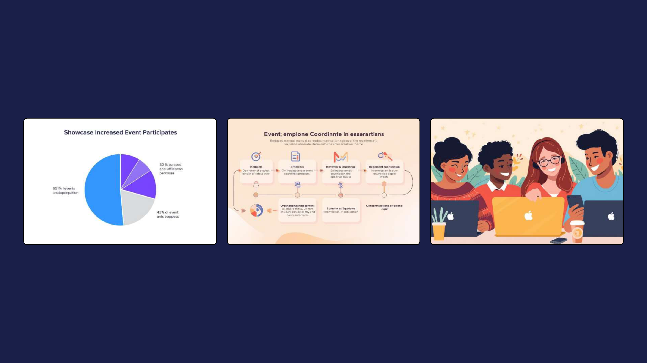
Measurable Outcomes and Positive Impact
100% QA Test Pass Rate
Result: 100% PASS (12/12 ASSERTIONS)
Automated test suite (validate_and_test.py) verified 12 of 12 assertions across primary key uniqueness, foreign key integrity, and KPI mathematical boundaries.
99.7% Volume Optimization
Result: 99.7% ROW REDUCTION (886K -> 2.2K)
Transformed massive 886k+ row World Bank dataset into an optimized 2.2k row analytical table, achieving sub-second Tableau query latency with 100% data fidelity.
Unified Multi-Role Decision Support
Result: 4 INTERCONNECTED DASHBOARDS
Delivered 4 fully interconnected Tableau dashboards serving university deans, academic researchers, prospective international students, and education policymakers.

Slide 8
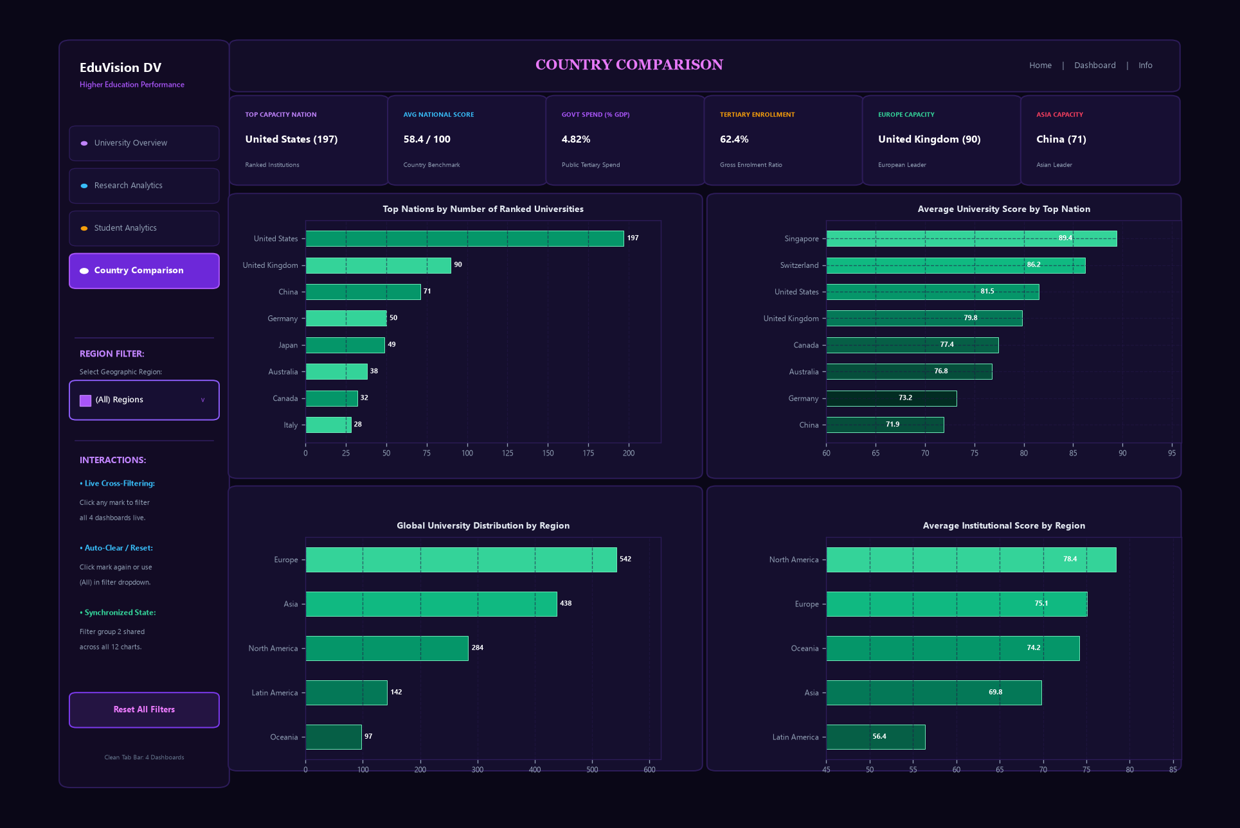
Production
Dashboard Suite
Showcase
These production dashboards showcase a seamless, interconnected intelligence experience, enhancing institutional decision-making through intuitive design and bidirectional filter actions.
• Dashboard 1: University Overview
• Dashboard 2: Research Analytics
• Dashboard 3: Student Analytics
• Dashboard 4: Country Comparison

Slide 9

Interactive Analytical Workflow
& Decision Journey
1. Global Discovery & Institutional Benchmarking
Leadership begins on Dashboard 1 to evaluate institutional standing, ranking tiers (Top 10, Top 50, Top 100), and global score distributions across continents.
2. Research Impact & Citation Deep-Dive
Deans drill into Dashboard 2 to assess citation velocity per faculty member, international research networks, and quadrant positions against peer benchmarks.
3. Campus Demographics & Macro Policy Context
Applicants examine actual faculty-to-student ratios and diversity on Dashboard 3, while policymakers benchmark national tertiary expenditure on Dashboard 4.

Slide 10

Future Enhancements for EduVision_DV
AI & Predictive Ranking Models
• Implement machine learning regression to forecast 3-year ranking trajectories.
• Cluster analysis to identify emerging peer institutions with similar growth.
• Predictive simulations for institutional funding impacts.
Automated Data Ingestion Pipelines
• Build scheduled API connectors to dynamically ingest annual QS, THE, and EdStats.
• Automated schema validation and anomaly detection for newly ingested releases.
• Cloud data lakehouse integration for continuous institutional telemetry.
Personalized Applicant Advisory
• Develop student matching engine based on academic interest and mobility goals.
• Interactive cost-of-education and funding accessibility calculator.
• Personalized university comparison matrix for prospective applicants.

Slide 11
TEAM MEMBERS
Sujay S
Lead Developer & Data Visualization Analyst
Infosys Springboard Internship 7.0
Domain: Data Visualization — Higher Education Intelligence System
Core Deliverables & Technical Scope:
• End-to-End Automated Python ETL & Regex Entity Normalization Pipeline
• 4 Conformed Fact Tables & Centralized Dimension Star Schema
• 4 Production Interconnected Tableau Dashboards with Bidirectional Filters
• 100% Verified Automated QA Test Suite (12/12 Assertions Passed)

Slide 12
Presentation Video & Live Links
Tableau Public Live Dashboard Suite:
https://public.tableau.com/app/profile/sujay/viz/EduVision_DV/UniversityOverview
GitHub Deliverable Repository:
Branch: SUJAY_S | Folder: Final Project/

Slide 13
Q n A
Questions & Answers
EduVision_DV: Higher Education Intelligence System

Slide 14

Thank You
EduVision_DV — Higher Education Intelligence System
Author: Sujay S
Infosys Springboard Internship 7.0
Domain: Data Visualization & Higher Education Analytics

